Slide 1
Unified mentor FrontEnd Development Internship :
Tic-Tac-Toe
My Portfolio
Weather App
To-Do App
Basic Calculator
Recipe Book
Music Player
Interactive Resume
Info
Graphics
Virtual Pet Simu
Thispresentationshowcaseswebdevelopmentproject:Countdown Timer.ThisprojectutilizeHTML,CSS, andJavaScript,demonstratingmycodingskillsandprojectdevelopment experience.Thisprojecthighlightmyabilitytocreateinteractiveandengaging webapplications,showcasingmypassionforwebdevelopmentandcommitment tobuildinghigh-quality, user-friendlywebsite.
A Web Development Showcase
Memory Card Game
Interactive Quiz
Countdown Timer
Blog Website
Virtual Art gallery
byMandadiRohitReddy
InternshipID:UMIP278665
M R
Chat Application
Interactive Story telling
Interactive Map
Image Slider
Expense Tracker

Slide 2
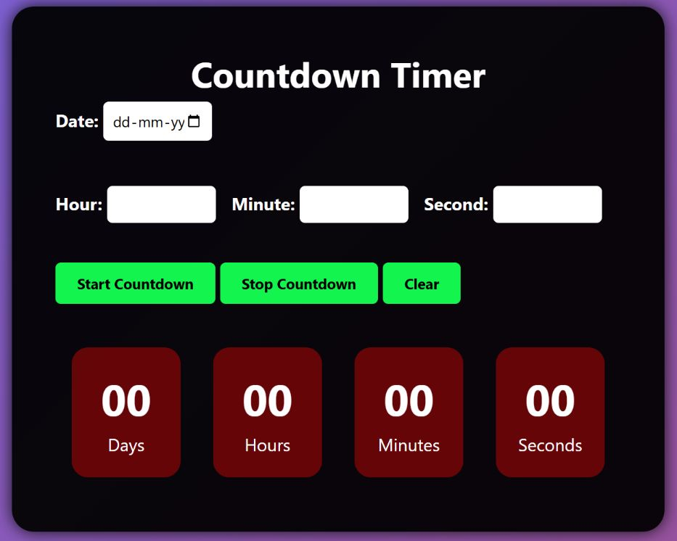

Project Title: Countdown Timer in HTML, CSS, and JavaScript

Slide 3
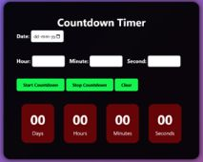
Introduction
A countdown timer is a clock that counts down from a set time to zero. It is a useful tool often used to create urgency, build anticipation, or indicate the remaining time for an event or deadline. In this project, we implement a dynamic countdown timer using core web technologies—HTML, CSS, and JavaScript.
Purpose of a Countdown Timer:
To build anticipation for an upcoming event or deadline.
To remind users how much time is left before something starts or ends.
To create urgency, often used in marketing for limited-time offers.

Slide 4
✅ Examples of Where Countdown Timers Are Used:
Product launches (e.g., “Launching in 3 days!”)
Online sales (“Sale ends in 1 hour!”)
Events and webinars (e.g., conference countdown)
Exam portals or quiz apps (time-bound tests)
Maintenance pages (“We’ll be back in...”)

Slide 5
Technologies Used
HTML: Structure of the Timer
CSS: Styling the Timer
JavaScript: Timer Logic and Functionality

Slide 6
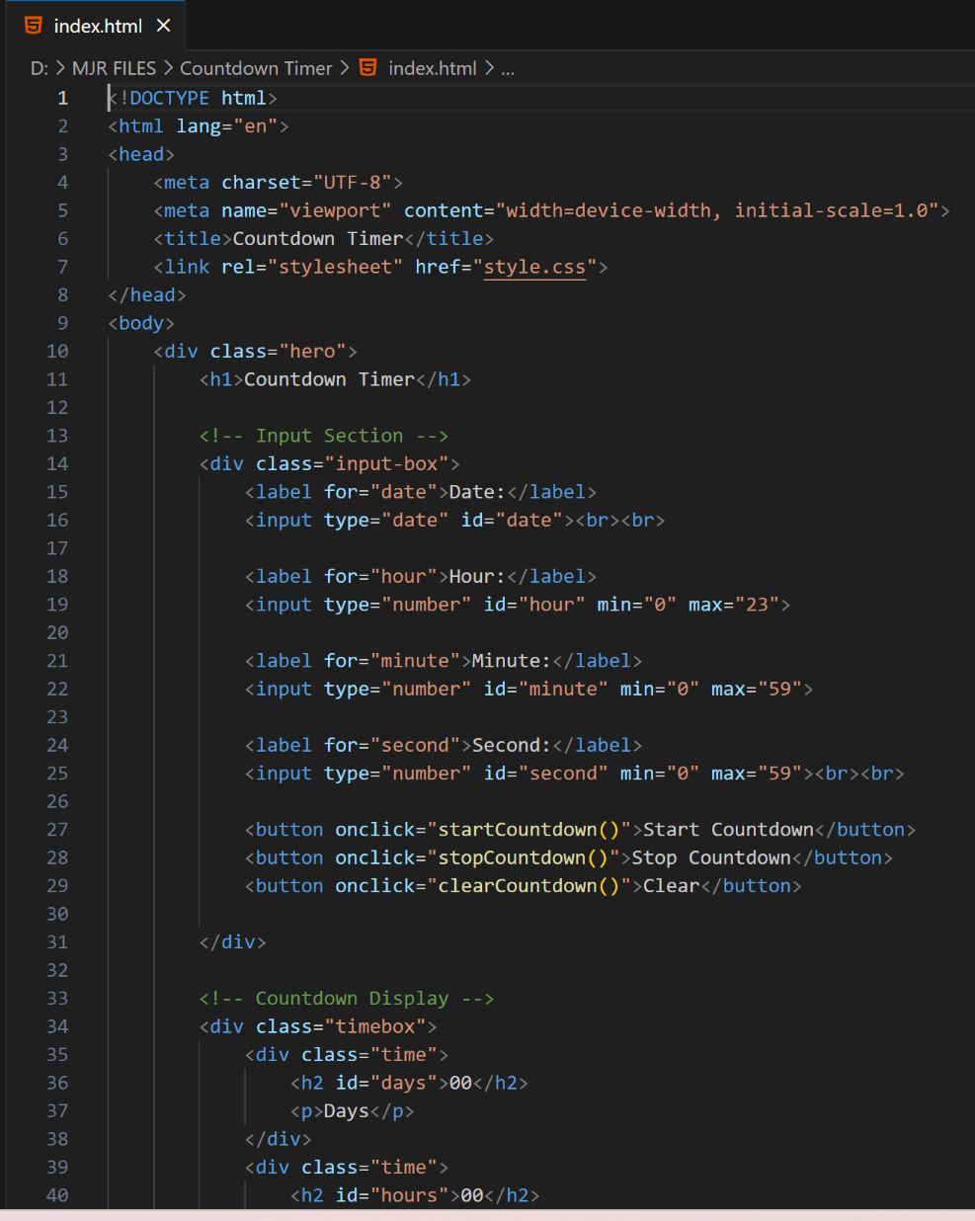
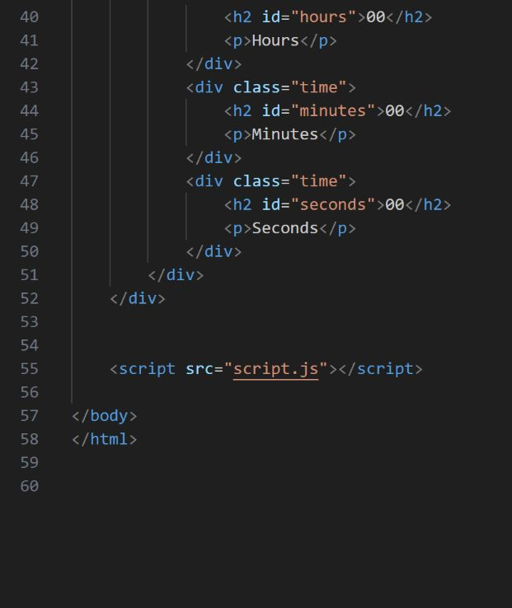
HTML Code

Slide 7
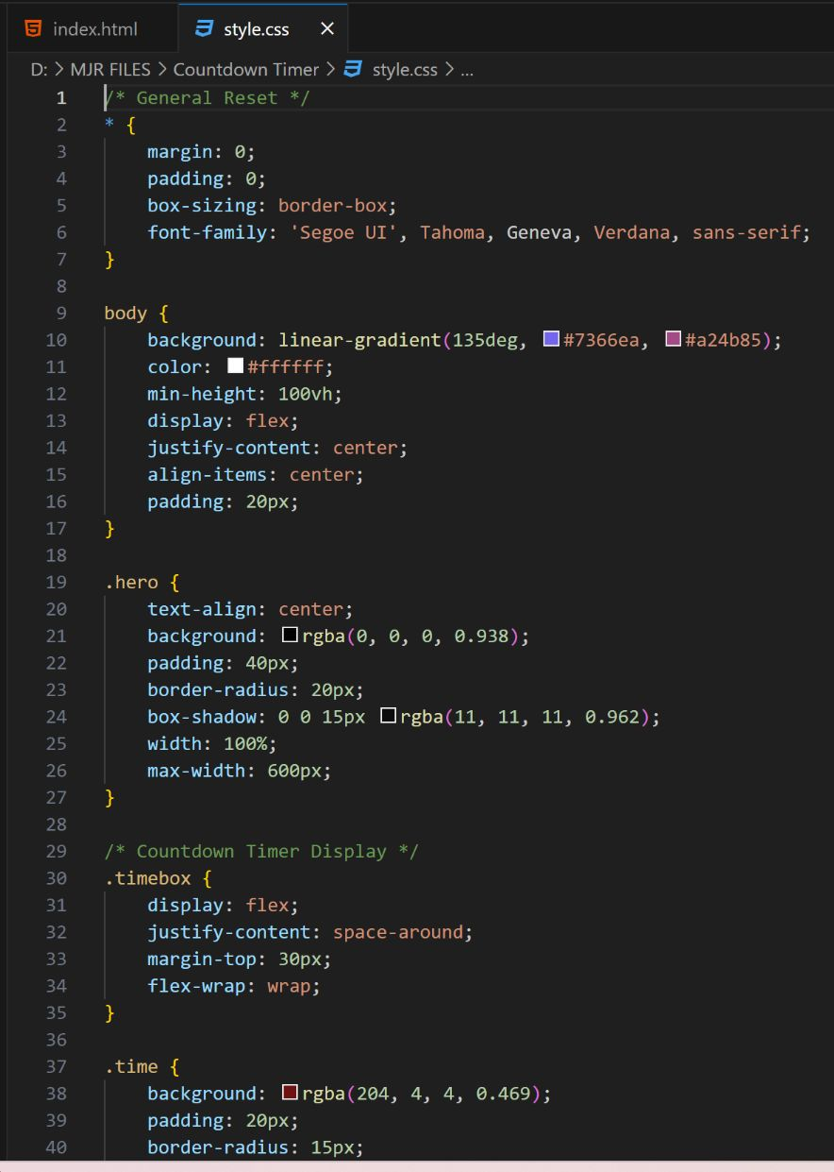
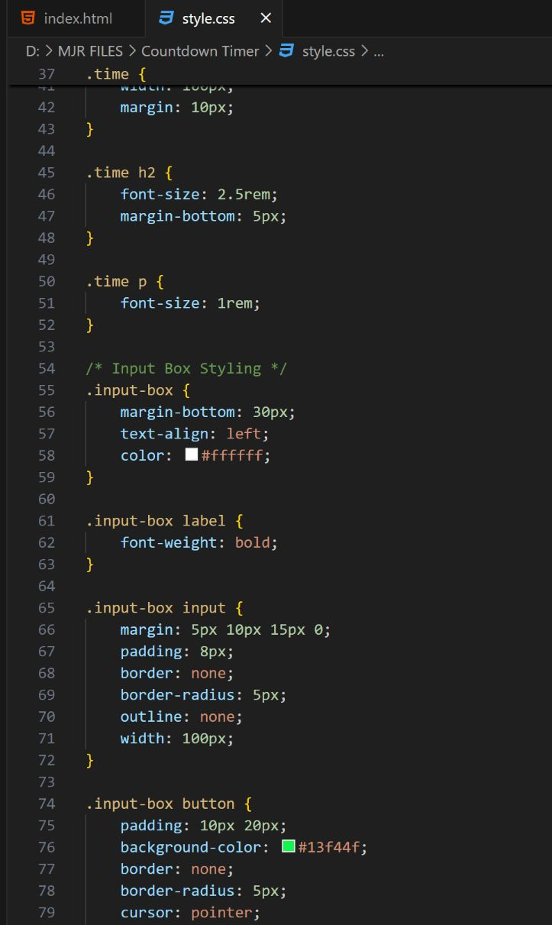
CSS Code

Slide 8
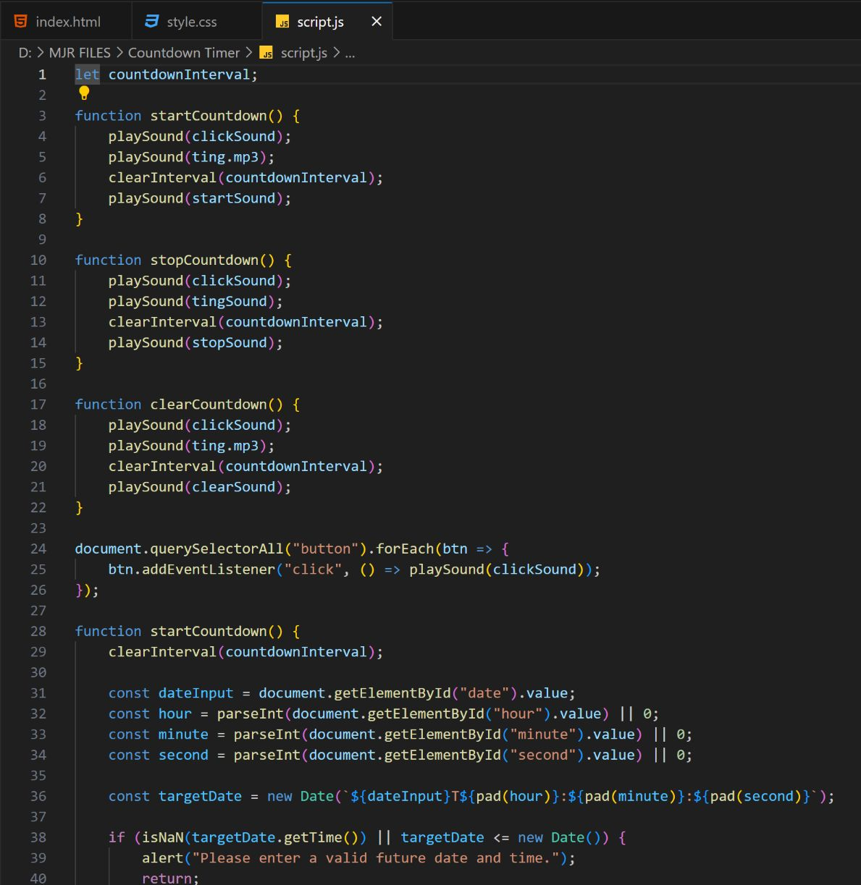
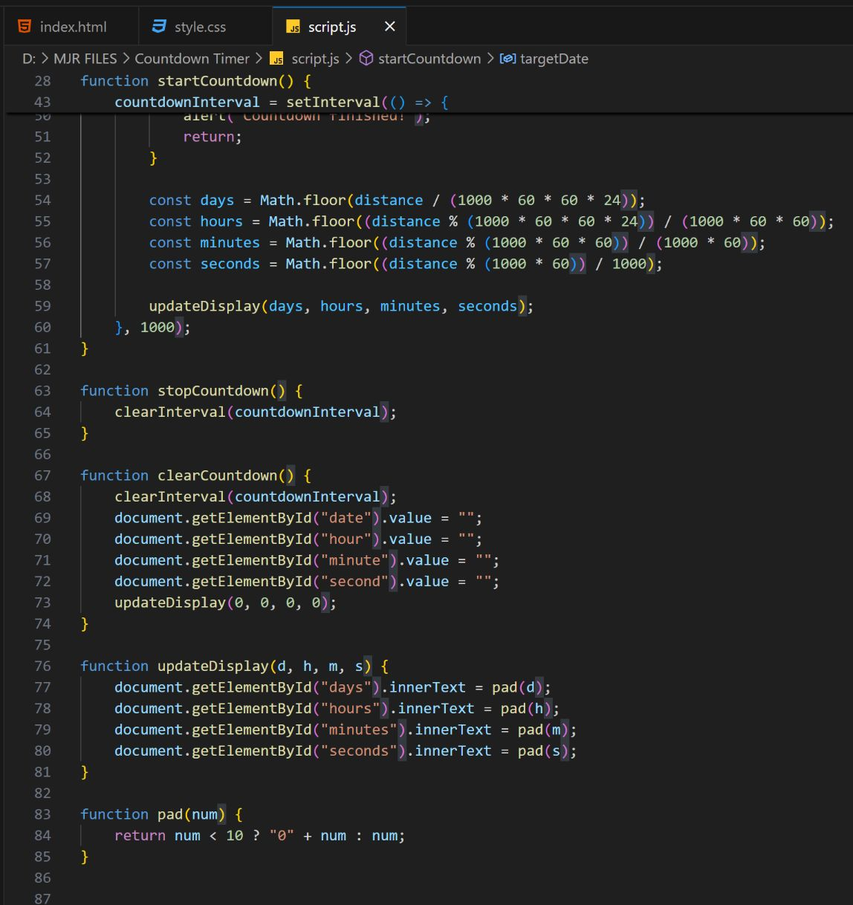
JavaScript Code (Logic)

Slide 9
Output:

Slide 10
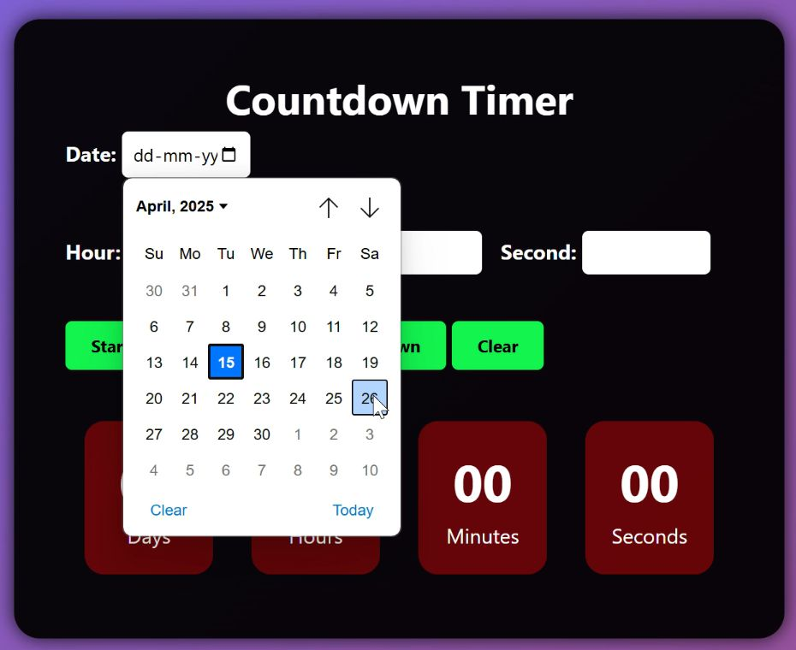
Live Demo
Preview of the Countdown Timer in action

Slide 11
Conclusion
We successfully built a functional countdown timer using HTML, CSS, and JavaScript.
The timer dynamically updates every second and displays time in a readable format.
This is a versatile and reusable component for many web applications.
Future Enhancements
User Input Support
Allow users to set their own target date/time via a form.
Sound or Alert
Play a sound or show a pop-up when the timer hits zero.
Responsive Design
Optimize the layout for mobile and tablet screens.
Theming Options
Add dark mode or custom color themes.
Multiple Timers
Support displaying multiple countdowns on one page.
Local Storage / Save State
Preserve timer progress if the user refreshes or revisits the page.

Slide 12
Social Media Links:
Website Link : https://prismatic-licorice-39f5da.netlify.app/
GitHub Link :
https://github.com/Mandadi2002/Unified-Mentor-FED/tree/main/Project-13%20CountDown%20Timer

Slide 13


